Slide 1
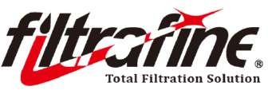
2023 ANFA NONWOVENS CONFERENCE
THE APPLICATION OF NONWOVEN IN INDUSTRIAL FILTRATION
Prepared by: HO CHAO CHUAN Ph.D.
Chairman of Bright Sheland International Co., Ltd.
Hong Kong, October 29-31
1

Slide 2
Personal background
Bachelor of Chemical Engineering, Tamkang University, Taiwan
EMBA, National Taiwan University, Taiwan
Ph.D of Chemical Material Engineering, Tamkang University, Taiwan
CTCI Process Engineer
Chairman of Bright Sheland International Co., Ltd. 1985 to now
Chairman of Taiwan Filtration and Separation Society 2018 - 2022
HO CHAO CHUAN

Slide 3
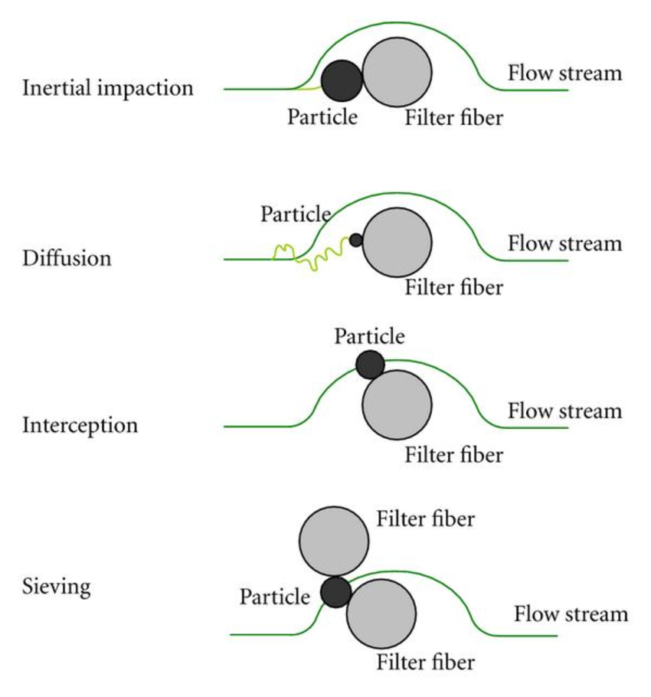
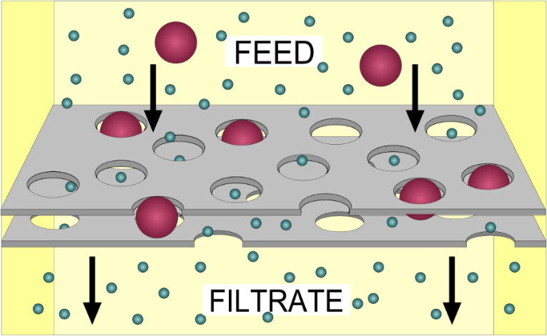
Background information
Mechanism of filtration
Industrial filtration is a process used in various industries to separate and clean substances by passing them through filters. It's crucial for ensuring product quality and process efficiency. This is used in sectors like manufacturing, food and beverage, water treatment, pharmaceuticals, and more to remove particles, contaminants, and impurities from liquids and gases.

Slide 4
Background information
Each industry has its own understanding of filtration and filtration quality standards (also influenced by regional/country-specific laws) that keep evolving:
Filtration efficiency
Microbial rating
Beta ratio
Nominal rating
Absolute rating
Filter permeability

Slide 5
Background information
Microbial rating
A filter’s micron rating refers to the size of the gaps between the filter media components, which controls the size of the contaminants that can pass through the filter.
For example, if your water has dirt particles measuring 5 µm and your whole-house system’s sediment filter has a micron rating of 5 µm, it can effectively filter out those sediments and anything larger than 5 µm.

Slide 6
Background information
Beta ratio
Beta ratio equals to the ratio of the number of particles of a minimum given size upstream of filter to the number of particles of the same size and larger found downstream. Simply put, the higher Beta ratio the higher the capture efficiency of the filter.
Particle upstream
1000
Particle after filter
10
Beta Ratio
100
Number of particles before filtering – Number of particles after filtering
Filtration efficiency, % =
Number of particles before filtering
The Beta ratio is a sign of how well a filter controls particles. Thus, filters with higher Beta ratio hold more particles and have higher efficiency.

Slide 7
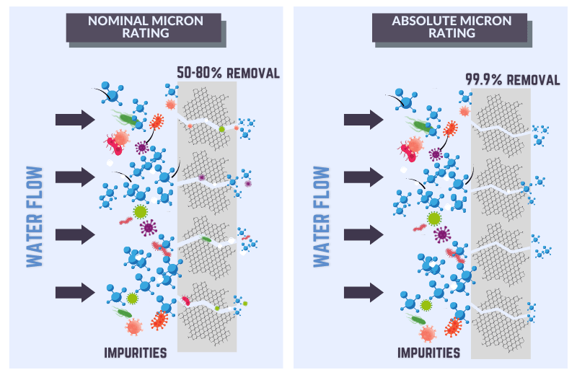
Background information
Absolute rating and nominal rating:
A nominal rating means that the filter will remove 90% of particles of that micron rating, while an absolute rating guarantees 99.98% removal of all particles of that micron rating.
Absolute filters are a good choice if you want to eliminate a specific contaminant, but nominal filters are the most commonly used.

Slide 8
Background information
Filter permeability:
Filter permeability is a significant term used to measure the endothelial permeability to fluid. There exist permeable sheath in the walls of the filter that allows the fluid (oil, fuel, water) to get in and out. It related to pressure drop comprising of the filter medium, flow rate, fluid through it, fluid temperature, filtration time, filter size etc.
The standard Unit of measurement for permeability is m³/(h.m²).
L_{p} measuring the fluid filtration coefficient
P_{a} measuring the apparent permeability
P_{d} is the diffusive component of solute permeability
σ is the solute reflection coefficient.
ΔP The hydrostatic pressure
Pa = Pd + Lp (1 – σ) △P

Slide 9
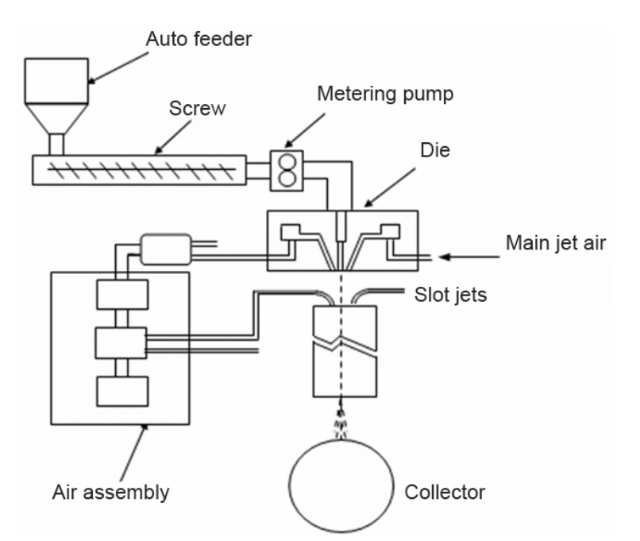
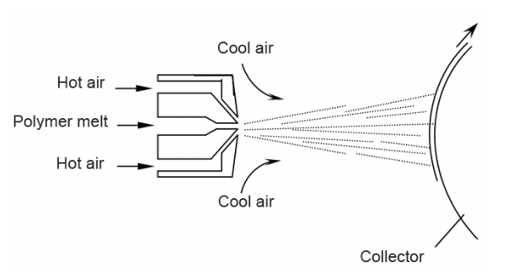
The melt blown process
The melt blown process
The melt blown technology is a one-step process in which high velocity air blows a molten thermoplastic resin from an extruder die tip onto a conveyor or take-up screen to form a fine fibrous and self-bonding web.
Schematic diagram of melt blowing equipment
Schematic diagram of melt blowing principle

Slide 10
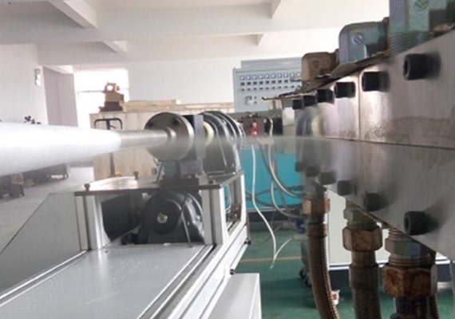
The melt blown process
Melt blown filter cartridge:
The melt blown cartridge filters are cylindrical cartridges made from the finest polymer fibers melt blown and collected over a rotating spindle.
Notes:
The polymer travels through a tubular path and is blown out through the opening and the polymer steam is air dragged to form fibers. These fibers are collected on the rotating spindle to form a gradient structure and then pressed and sintered.

Slide 11
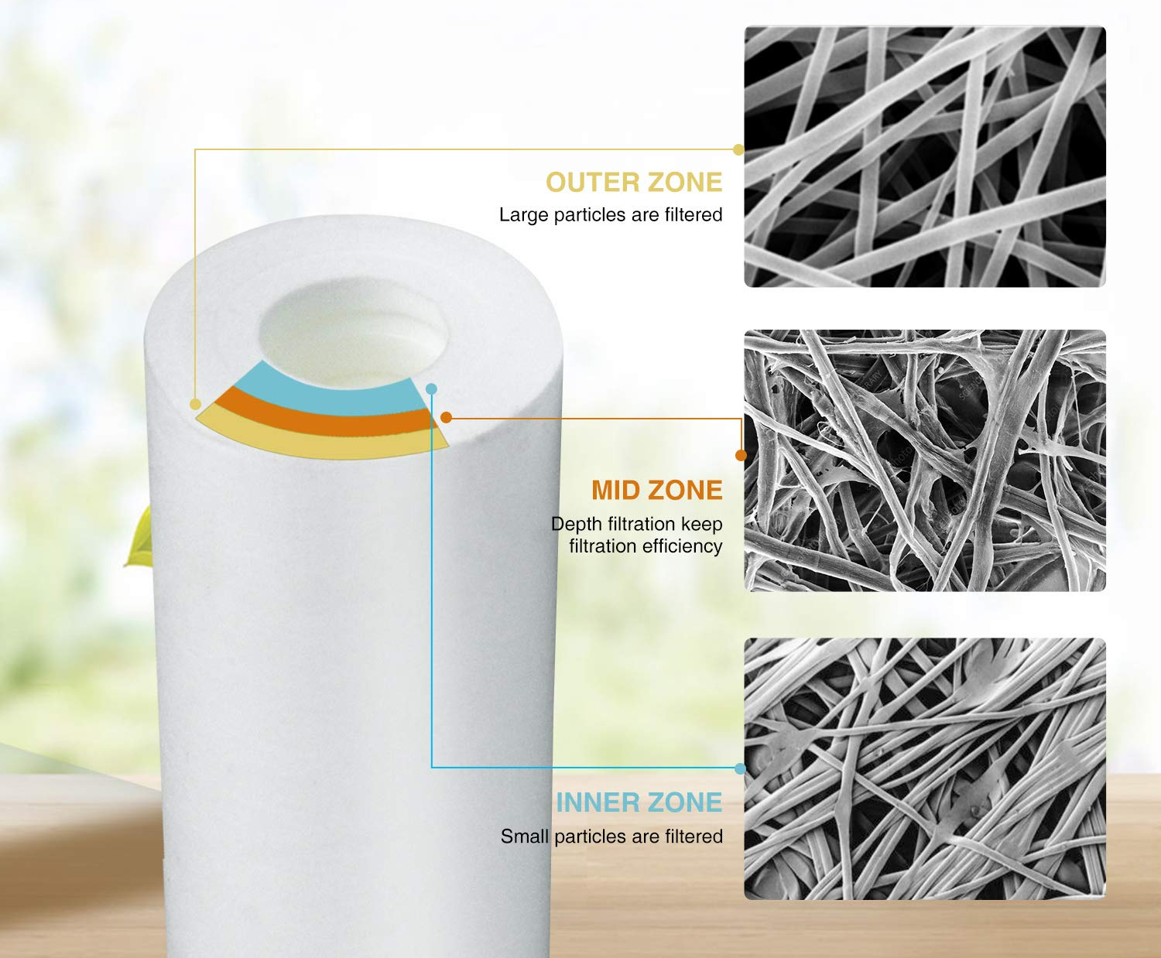
The melt blown process
Melt blown filter cartridge:
Unique Melt Blown Media
All polypropylene
Graded pore structure for true filtration
Consistent performance
High void volume for high dirt holding capacity
Good dirt holding capacity
Premium grade materials that meet FDA standards
Ability to sustain low pressure drop operating conditions
Withstand mildly corrosive liquids and chemicals
Economical and efficient (value for money)
Micrograph of Melt Blown filter media

Slide 12
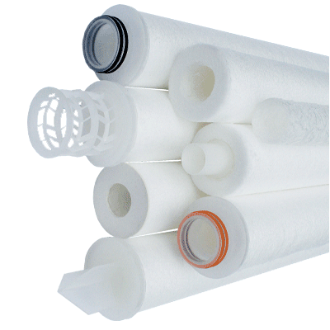
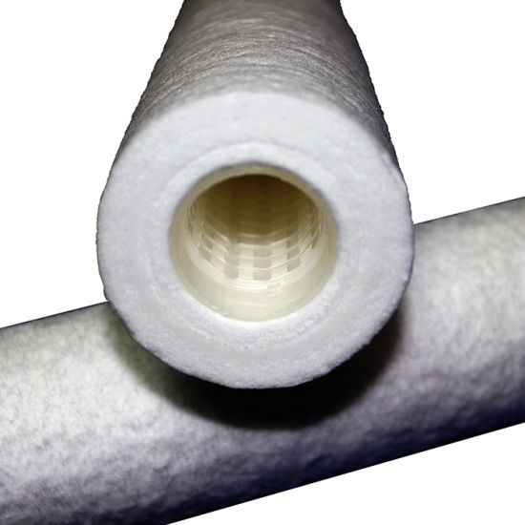
The melt blown process
Melt blown filter cartridge:
End Caps
Several optional configurations
Thermally bonded to media
No adhesives
Moulded Core
For high strength resistance
Gasket Seals
Various choices in o-rings or gaskets
Prevents fluid bypass

Slide 13
The melt blown process
Melt blown cartridge filter:
Melt-blown cartridges are frequently used in a number of industries for a variety of applications.
Photographic fluid filtration
Plating of metals
Water and waste water filtration
Applications involving highly viscous liquids
Pre-filtration for Reverse Osmosis
Melt blown cartridge filter
Textile Printing Inks and specialty coatings
Pre-filtration in desalination
Chemical filtration applications
Pre filtration for industrial water treatment systems
Applications that involve filtration of weak acids & bases, chemicals and solvents.

Slide 14
The melt blown process
Melt blown sheet:
Through the plate extruder, the molten molecules are squeezed into the high-speed hot air flow, then the polymer melt is spun out through the spinneret of the ultra-fine nozzle to form extremely fine fibers and blow it horizontally onto the drum or vertically to the collector filtered nets.
Self-bonding
Large area/weight ratio
Adjustable structure of pores and capillaries
Hydrophobic/oleophilic
High filtration efficiency
Electrostatically charged
Optional additives

Slide 15
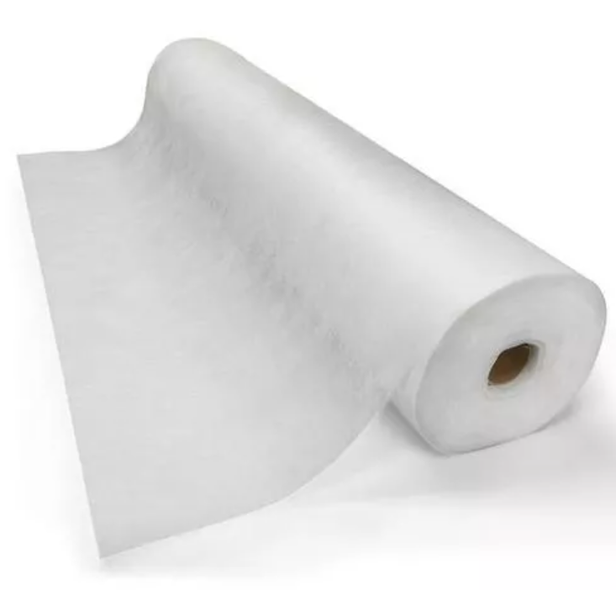
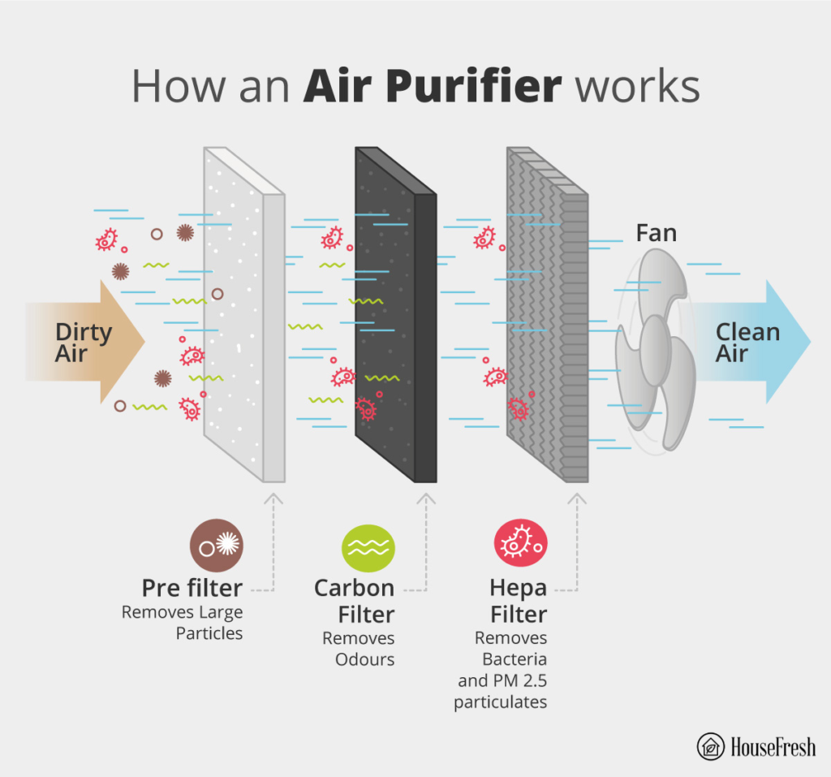
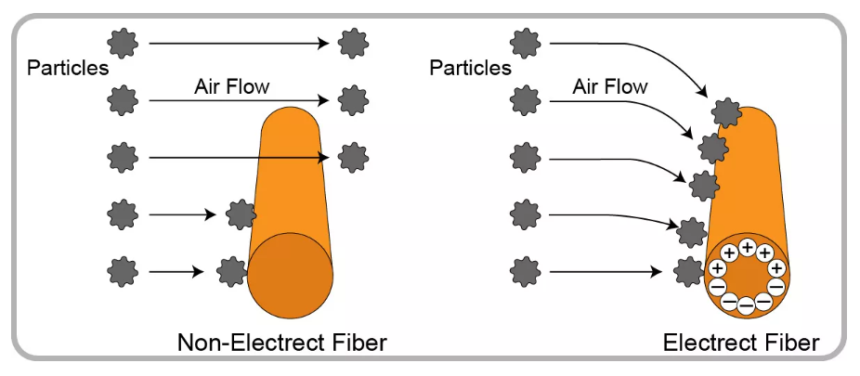
The melt blown process
Melt blown sheet application in filtration:
Melt blown for air filtration
Melt blown sheet for air filtration
With the Electrostatically charge ability, the nonwoven can provide a high filtration efficiency with low pressure drop

Slide 16
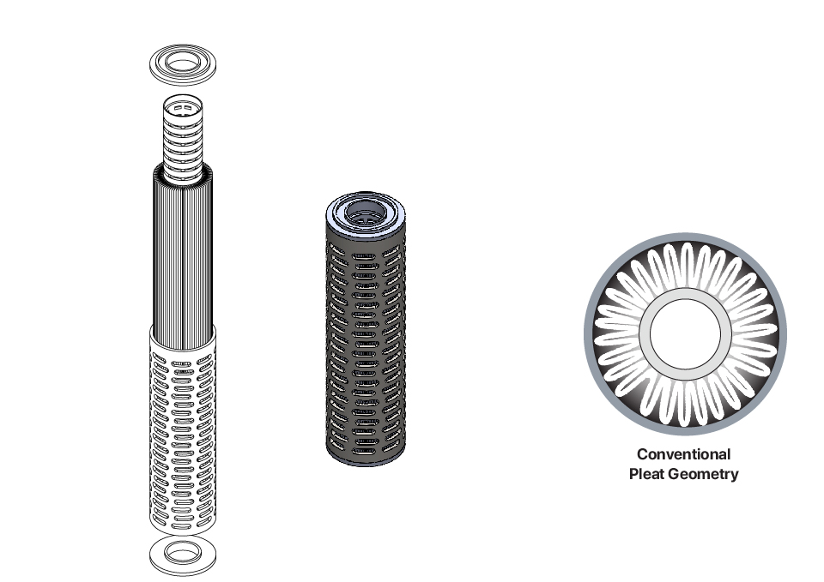
The melt blown process
Melt blown sheet application in filtration:
Pleated filter:
The cartridge media is pleated, so that the surface area of the filter increases and holds a large amount of sediments.
Pleated filter | Non-pleated filter
Higher level of filtration Wide variety of sizes Efficient at capturing microscopic airborne particles and large particles Can filter out dust mites, pollen, mold, pet dander, lint, dust, insects Extended lifespan, durable | Higher level of filtration Wide variety of sizes Effective at capturing large particles Can filter out lint and dust Do not last very long

Slide 17
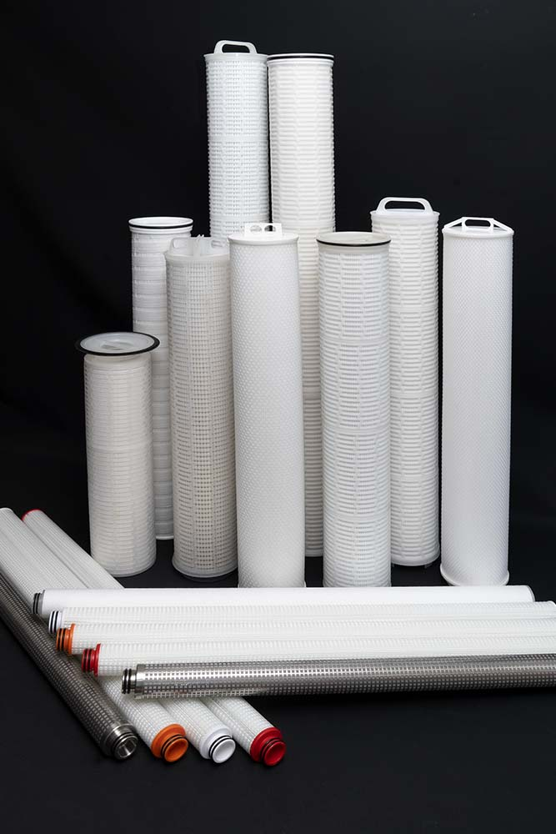
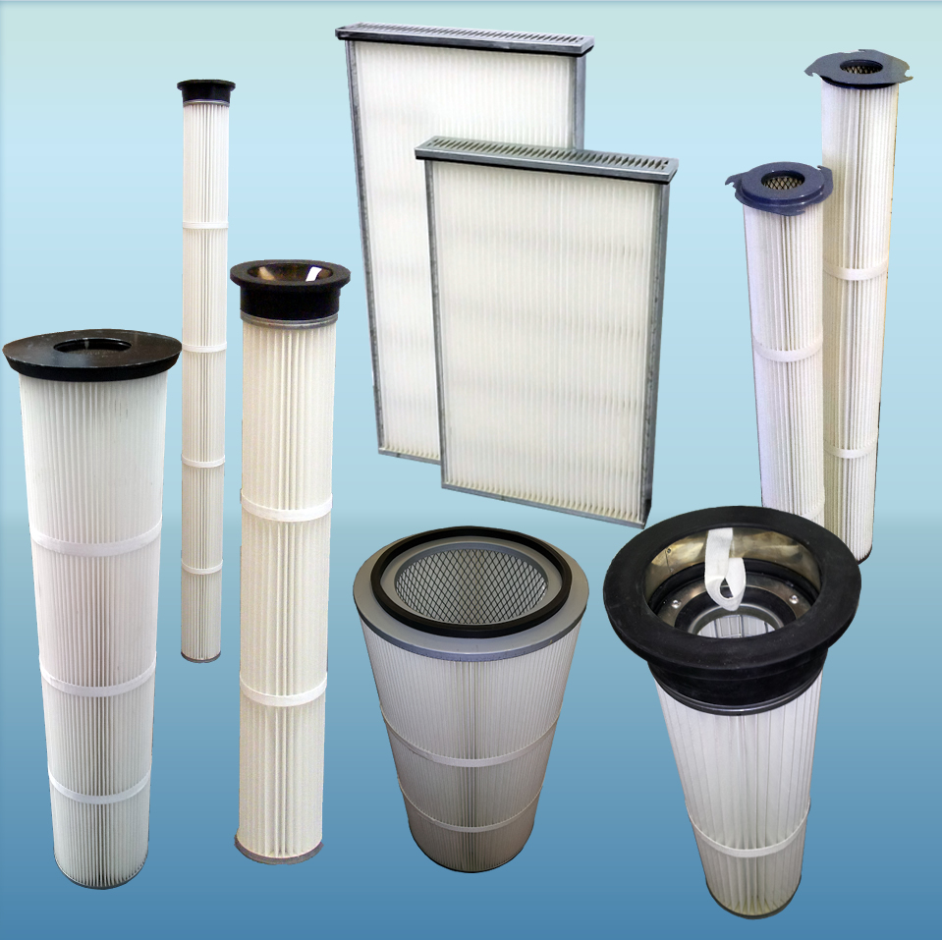
The melt blown process
Melt blown sheet application in filtration:
Pleated filter:
Pleated filters can be applied in liquid and air filtrations.
Example products for air filtration
Example products for liquid filtration

Slide 18
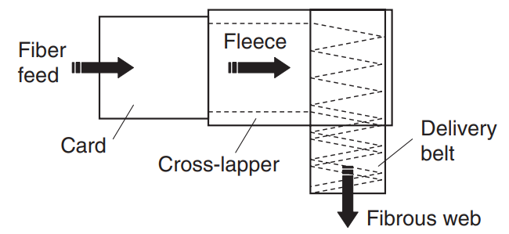
Carding process
Carding process:
The fibers from the fleece at the exit of a card are essentially parallel, cross-lapping is necessary to give some strength in the lateral direction.
A web is the basic structure of fiber to fabric nonwovens
It is a loose mat of fibers
Webs require bonding for stability
Carded fabric applications:
All fiber to fabric products
Bandages
Some pre-moistened wipes
Apparel interlinings

Slide 19
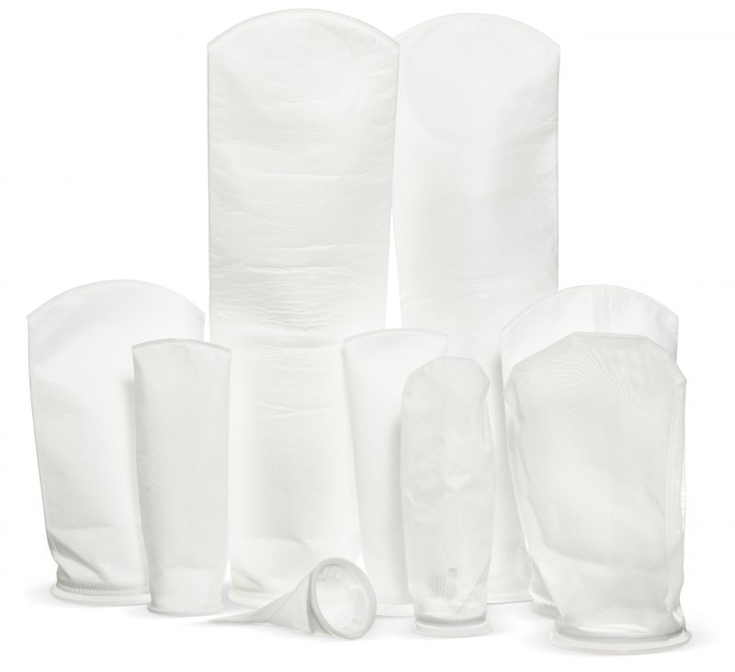
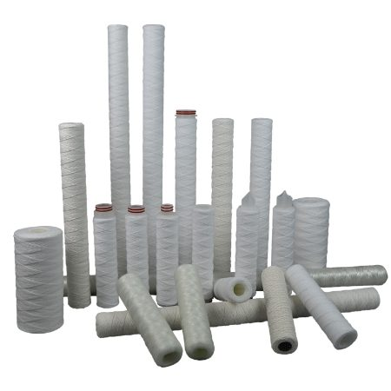
Carding process
Application of nonwoven from carding process:
Carding process
Needle looms
Roving process
Nonwovens
Coarse yarn
Liquid filtration: filter bags
Air filtration
Liquid filtration

Slide 20
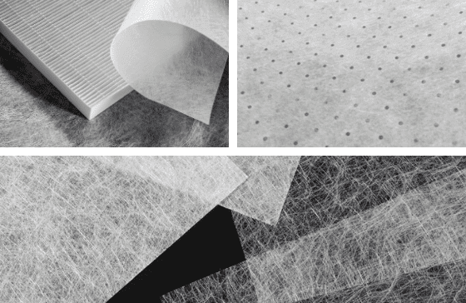
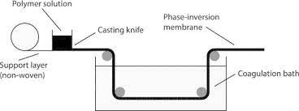
Membrane support layer
Membrane support layer:
Membrane support nonwovens are special materials that support thin membranes in applications like filtration. They offer strength, structure, and extra functions. They're made by bonding fibers, not weaving. They're crafted through processes like forming fibers into a web (Dray-laid, Wet-laid, spunbond or meltblown), bonding (Thermal bonding, mechanical bonding, or chemical bonding), and finishing.
Membrane support layers
Membrane fabrication diagram

Slide 21
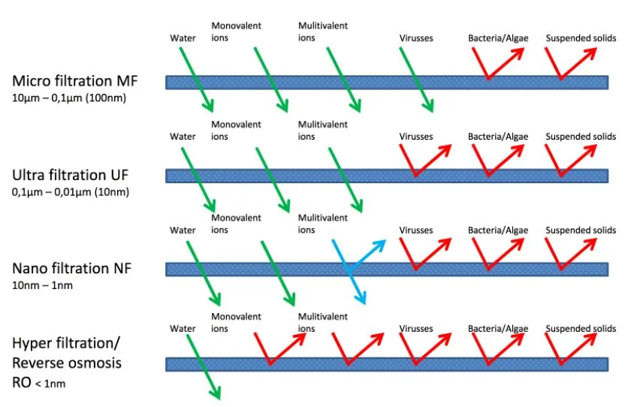
Membrane support layer
Membrane support layer:
Mostly, nonwoven support layer will be used to fabricate MF, UF, NF, and RO.

Slide 22
Membrane support layer
Membrane support layer:
Range of Application:
MF: mainly used in the removal of pathogenic bacteria, the pretreatment processes, the removal of algae and granular impurities in surface water of drinking water, etc.
UF: mainly used in mineral water, drinking water processing; the pretreatment or post treatment of RO membrane, the reuse of condensed water and reclaimed water, the treatment of municipal water, urban and rural drinking water, sand filter backwashing water and wastewater filtration, etc.
NF: mainly used in the pretreatment of RO process, the purification of drinking water and industrial water, wastewater purification treatment, the concentration of valuable components in the process, etc.
RO: mainly used in the preparation of purified water, industrial ultrapure water and medical ultrapure water, the desalination of salt water, the concentration, separation and purification of water and preparation of pure water in chemical process, the reuse of industrial waste water, etc.

Slide 23
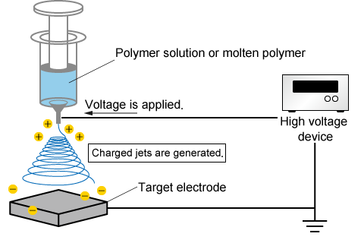
Electrospinning nonwoven
Electrospinning process:
Ultrafine fibers by using an electric field. Polymer solution is drawn into thin fibers, forming a porous structure. Benefits include fine fibers, customized properties, and uses in filtration, medicine, and energy.
A drawback of electrospinning is its slow production due to the intricate process of creating fine fibers individually. The method can also be expensive and complex, which can limit its widespread use. In addition, finding solvent with friendly environment ability is a key.

Slide 24
Electrospinning nonwoven
Application of nonwoven from electrospinning process:
Electrospun nonwovens excel in filtration due to their fine fibers, high surface area, and interconnected pores.
They're used for air purification, water treatment, oil-water separation, and fine particle removal.
These materials efficiently capture particles, contaminants, and even specific gases, enhancing filtration processes in various applications..

Slide 25
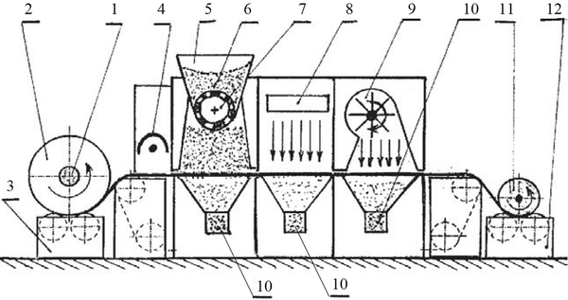
Nonwoven with AC integrating
How activated carbon nonwoven made?
Activated carbon powder can be integrated into nonwoven materials through two processes: blending and coating. In blending, the carbon powder is mixed with polymer fibers before nonwoven formation. In coating, carbon powder is applied onto an existing nonwoven.
1 roller; 2 nonwoven fabric; 3 let-off drive; 4 string electrode 5 container; 6 active carbon; 7 feeder; 8 heating radiator 9 blower fan 10 chute 11 take-up roll; 12 take-up drive.
DOI:10.1007/s10853-016-9741-x

Slide 26
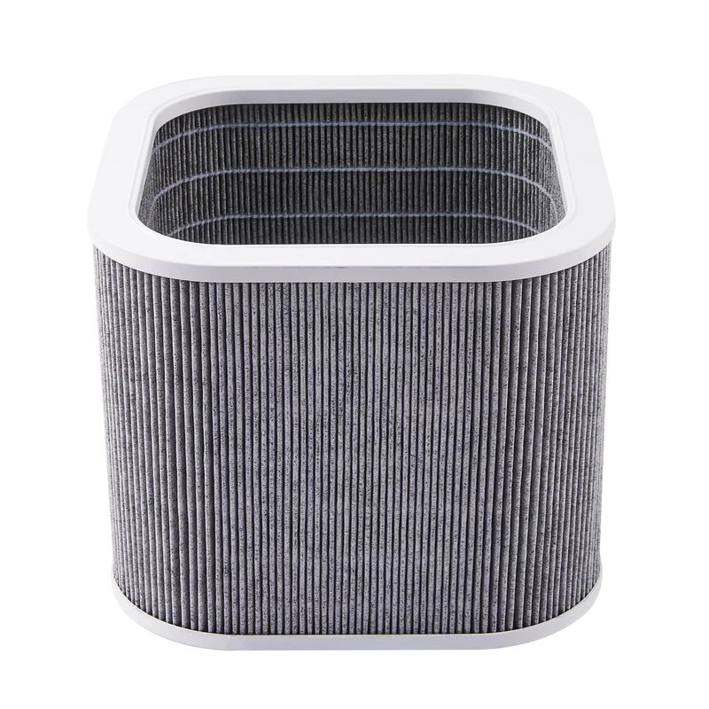
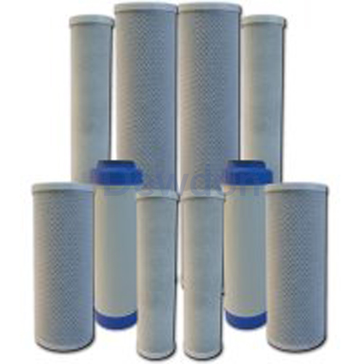
Nonwoven with AC integrating
Activated carbon nonwoven application:
Activated carbon integrated into nonwoven materials enhances filtration by capturing particles and adsorbing contaminants and odors. Applications include air and water purification, VOC removal, odor control, and industrial processes requiring effective filtration and adsorption.
Activated carbon air filter
Activated carbon liquid filter

Slide 27
THANK YOU FOR YOUR ATTENTION
27

